Slide 1
Drive Your Server Like You Stole It
HOTSOS 2017
Andy Weiss & Kirby Sand

Slide 2
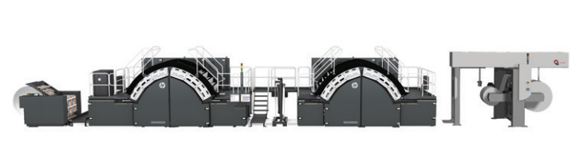
Introduction
We work for HP Inc. in Corvallis Oregon
We are on a team that builds really big printers
Engineering Analytics
Analytics on large datasets to provide insights to the engineering teams, the tiered support organization, and to the end customer.
Failure mode detection
Machine performance
Fundamental engineering models
Our Data
Raw sensor information
temperature, pressure, speed, tension, vision system output, etc.
Device status information
Alarms, faults, compute system usage, etc.
Production information
Jobs, consumables, operator interactions, etc.
The data is linked only by the device it came from and the timestamp.

Slide 3
Presentation Overview
Problem Statement
Experiment Design and Results
Conclusions & Future Work
Acknowledgements
Questions

Slide 4
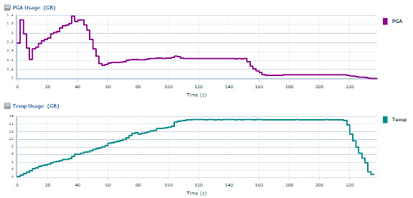
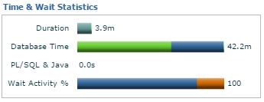
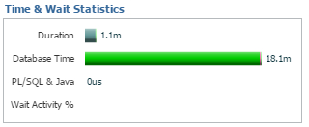
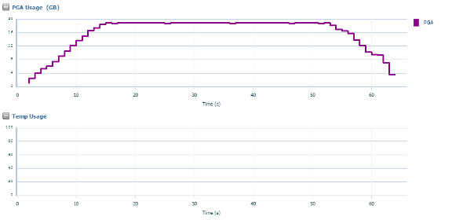
Why are we going to temp?
1.4GB PGA
11.2.0.4
PGA 800GB
72 cores
16GB Temp
Same query with a manual sort area size
19GB PGA
0 Temp

Slide 5
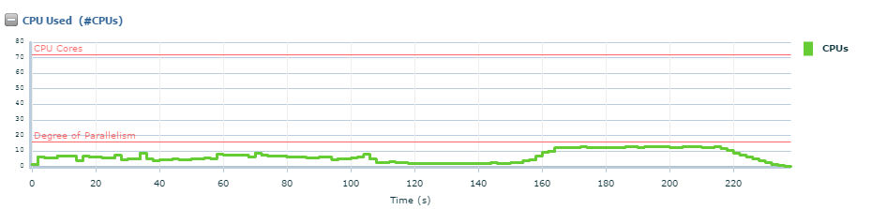
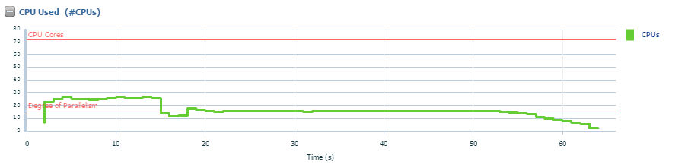
Which also causes inefficient utilization of CPU

Slide 6
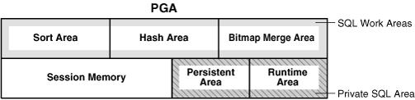
PGA Overview
Parameters
PGA_AGGREGATE_TARGET
WORK_AREA_SIZE_POLICY
Manual/Auto
Different Work Areas
SORT_AREA_SIZE
HASH_AREA_SIZE
Etc.
How do we measure it?
V$PGASTAT
V$PROCESS
V$SQL_WORKAREA_ACTIVE
V$SQL_WORKAREA

Slide 7
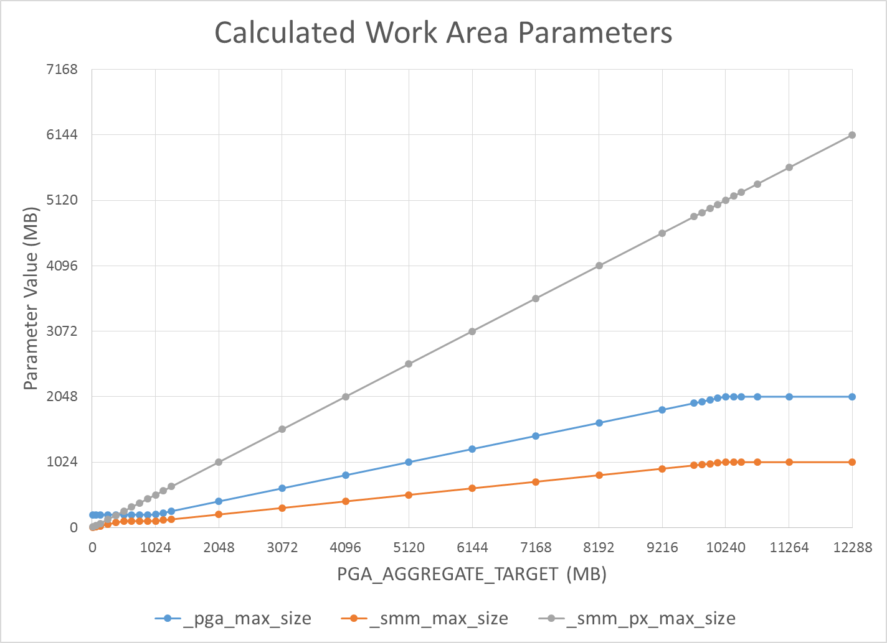
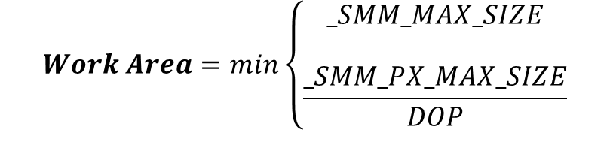
PGA Sizing Calculations
_PGA_MAX_SIZE:
max ( 200MB , min ( 2GB, 20% of PGA_AGGREGATE_TARGET ))
_SMM_MAX_SIZE:
min ( 20% of PGA_AGGREGATE_TARGET, 50% of _PGA_MAX_SIZE )
_SMM_PX_MAX_SIZE:
50% of PAT
$$Work Area=min\left\{\begin{aligned}_SMM_MAX_SIZE \\ \\ \frac{_SMM_PX_MAX_SIZE}{DOP}\end{aligned}\right.$$

Slide 8
Let’s set up a test … how hard can it be?
12.1
512G ram
16 cores
What we thought we knew
What we wanted to know
What we actually knew

Slide 9
Experiment Overview (Representative Tables & Queries)
Filter Parent/Child Join
Tables
PARENT_TABLE_V1
50M Rows, 1GB
CHILD_TABLE_V1
5B rows, 100GB
Filter with WHERE clause
Single Table Analytics
Tables
CAPSTONE_PARALLEL_TEST_V1
32M rows, 7GB
Standard Analytic Functions
Avg/Sum/Count
Parent/Child Analytics
Tables
PARENT_TABLE_V1
50M Rows, 1GB
CHILD_TABLE_V1
5B rows, 100GB
Standard Analytic Functions
Avg/Sum/Count
Windowing Functions
Tables
LEAD_LAG_TEST_V1
2.4B rows, 60GB
Windowing Functions
Lead/Lag finding changes

Slide 10
Experiment # 1: Tuning PGA
We manually set _pga_max_size
ALTER SYSTEM SET “_PGA_MAX_SIZE” = 2G
ALTER SYSTEM SET “_PGA_MAX_SIZE” = 4G
ALTER SYSTEM SET “_PGA_MAX_SIZE” = 6G
We forced DOP with a hint
/*+ PARALLEL(16) */
/*+ PARALLEL(32) */
/*+ PARALLEL(64) */
We forced buffer cache to be small
512MB (no table fits)
We tracked resource usage
Work Area Size (PGA and Temp)
V$SQL_WORKAREA_ACTIVE
Time (Run Time, CPU Time, IO Wait, DB Time)
Make it bigger
Make more of them
Can we stop going to temp if we enable larger work areas?

Slide 11
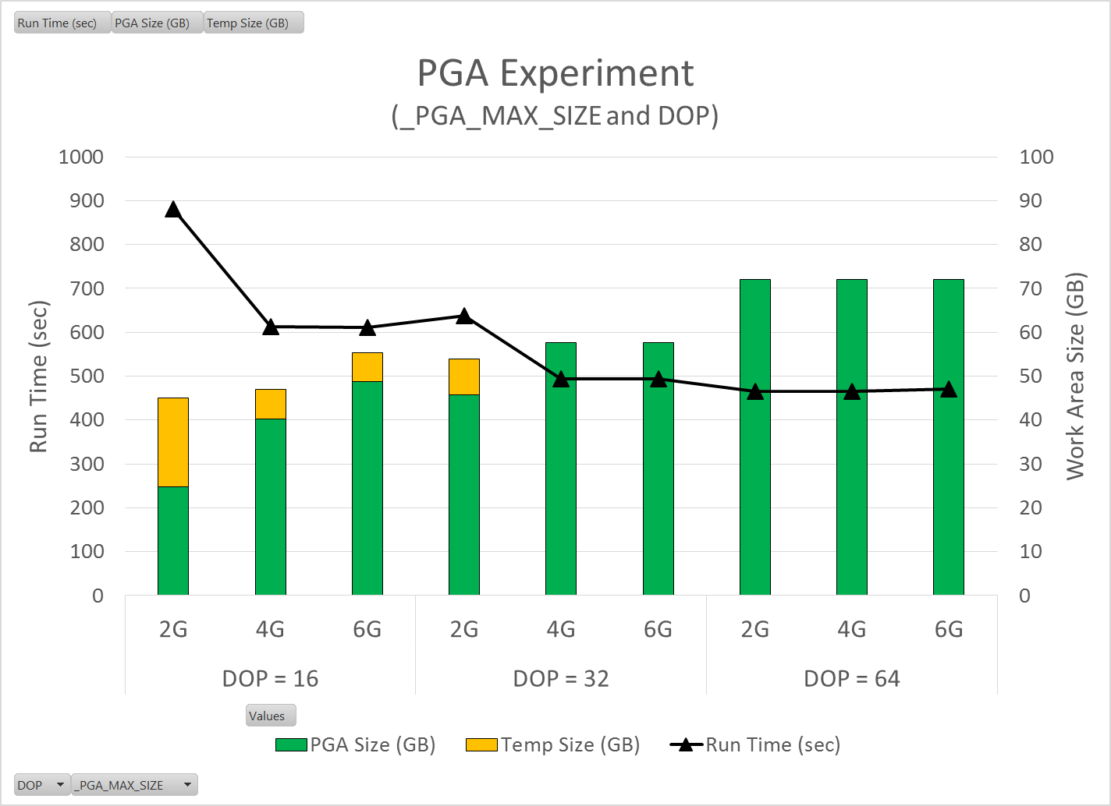
Experiment # 1: Tuning PGA
Biggest gains happen when we never go to temp.
Approx. 1.3X improvement over default
How do we prevent TEMP?
Really high DOP
Not ideal, requires lots of CPU allocation without a big improvement in run time.
Larger _PGA_MAX_SIZE
4G seems adequate. 6G didn’t provide any benefit.
A more attractive approach. Allows us to use more PGA and less CPU
Should use caution since it’s an undocumented parameter
Things certainly got faster, but with tables this large going to disk is another big bottleneck.
Default

Slide 12
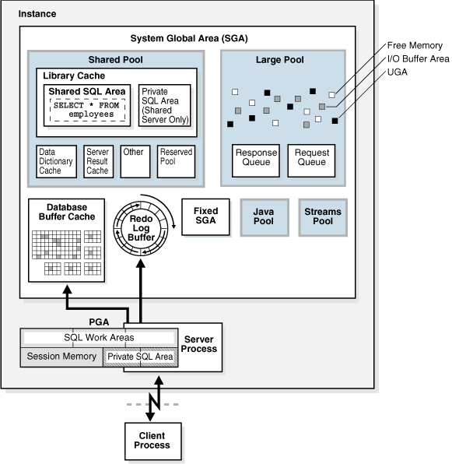
SGA Overview
Quick refresher on SGA memory structures
Areas of interest for us
Buffer Cache
In-Memory Column Store

Slide 13
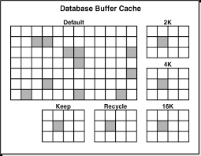

Automatic Big Table Caching
Parameters
PARALLEL_DEGREE_POLICY
DB_BIG_TABLE_CACHE_PERCENT_TARGET
_SMALL_TABLE_THRESHOLD
2% of buffer cache
How do we measure it?
V$BT_SCAN_CACHE
V$BT_SCAN_OBJ_TEMPS

Slide 14
Experiment # 2: Big Table Caching
We manually set parallel degree policy
ALTER SYSTEM SET PARALLEL_DEGREE_POLICY = MANUAL
ALTER SYSTEM SET PARALLEL_DEGREE_POLICY = AUTO
We manually set Big Table cache percent target
ALTER SYSTEM SET DB_BIG_TABLE_CACHE_PERCENT_TARGET = 10
ALTER SYSTEM SET DB_BIG_TABLE_CACHE_PERCENT_TARGET = 50
ALTER SYSTEM SET DB_BIG_TABLE_CACHE_PERCENT_TARGET = 90
New Default (no temp)
/*+ PARALLEL(32) */
ALTER SYSTEM SET “_PGA_MAX_SIZE” = 4G
We made buffer cache big
192GB
We tracked resource usage
Time (Run Time, CPU Time, IO Wait, DB Time)
BT Cache Object Status
V$BT_SCAN_CACHE
Can we put tables into memory and eliminate or minimize IO?

Slide 15
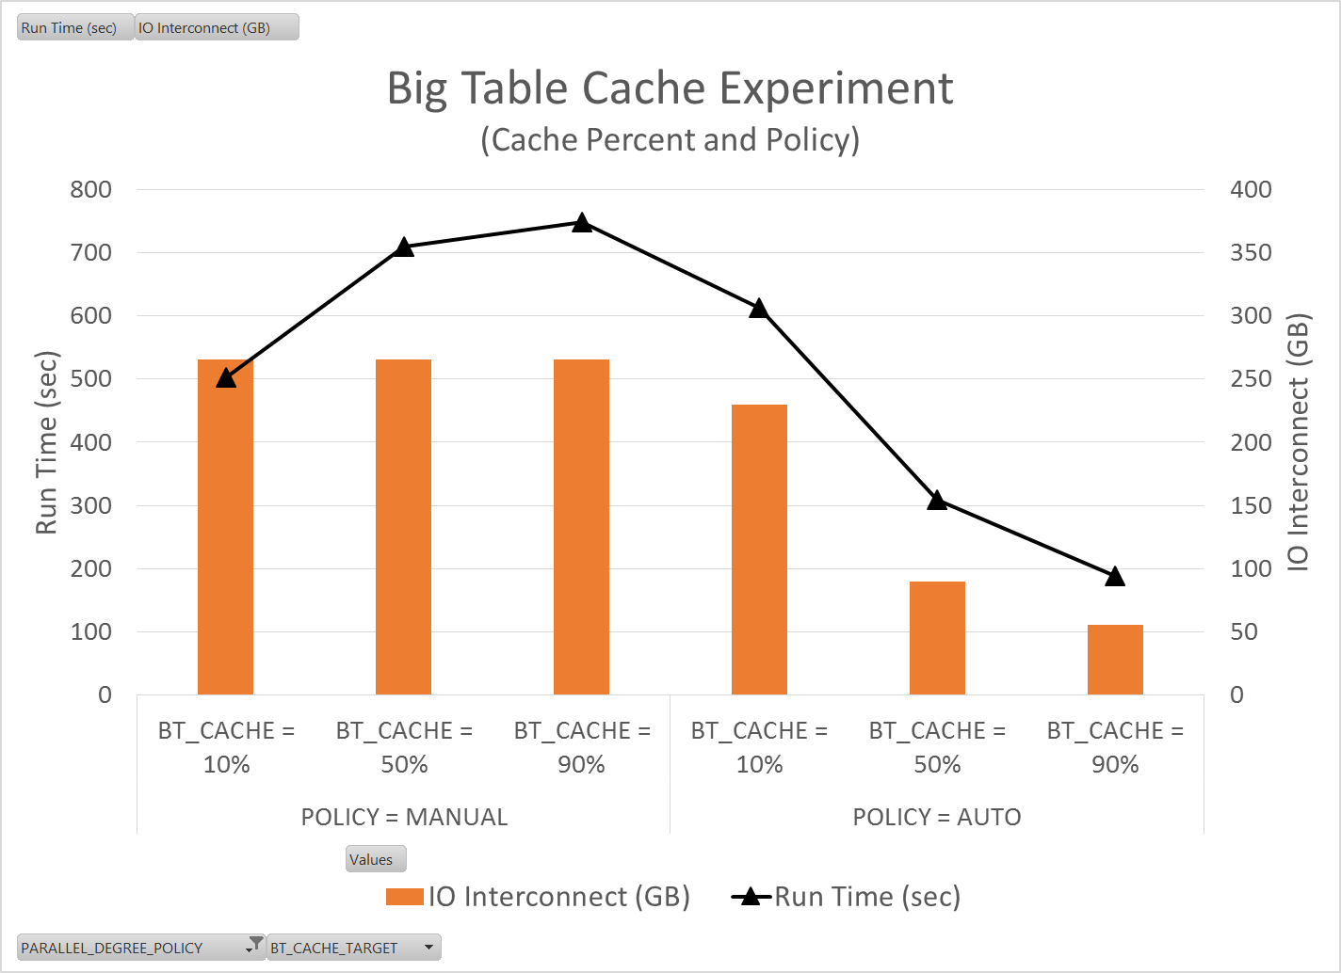
Experiment # 2: Big Table Caching
Policy = Manual
Notice that as the cache percent target gets large, the queries slow significantly.
Policy = Auto
As you increase the big table cache percent you get significant query speed improvements.
3.4X speed improvement vs the original default
2.6X speed improvement from the new default
However, you still have to go disk for some of the data.

Slide 16
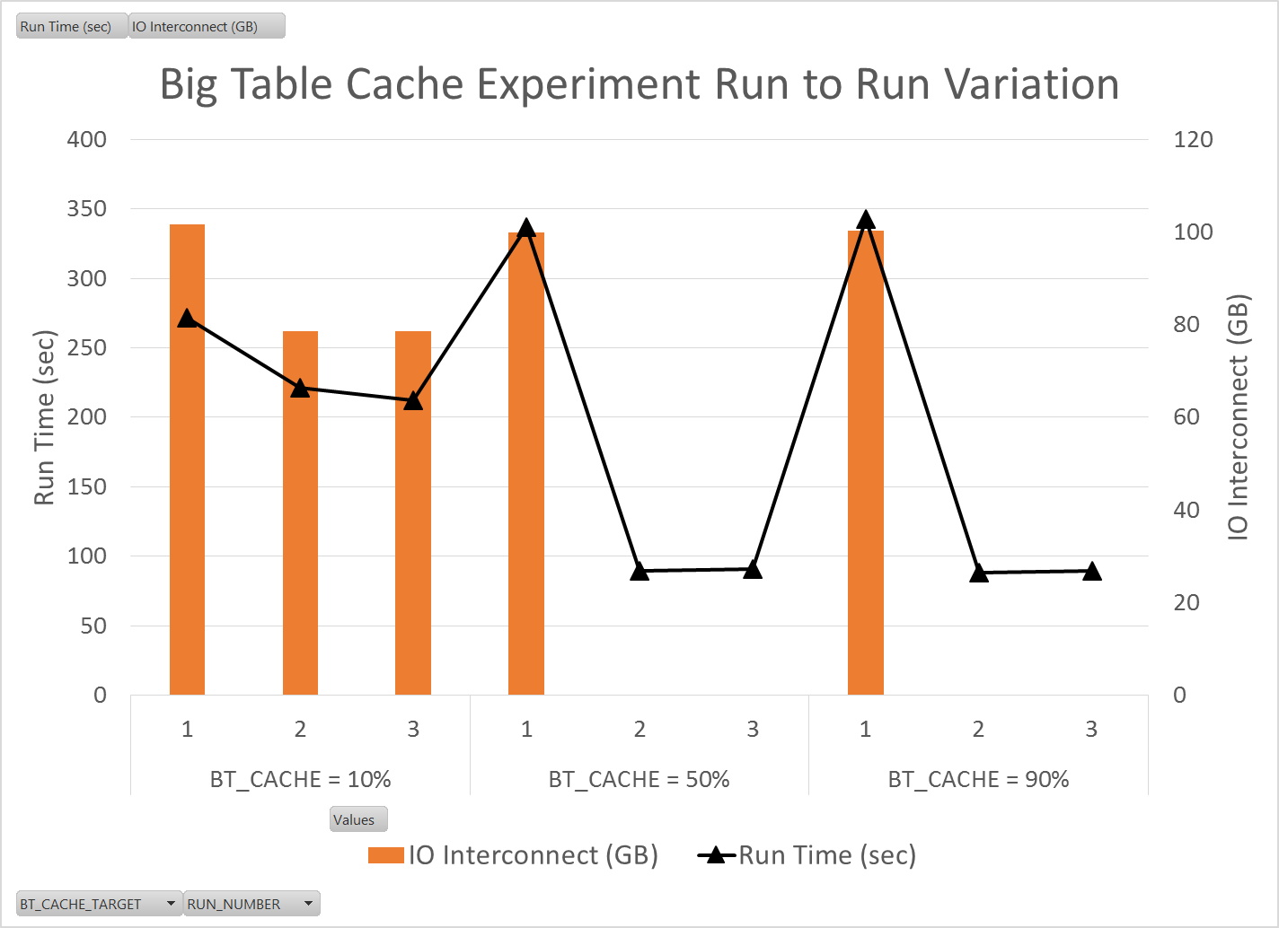
Experiment # 2: Big Table Caching
First run penalty?
It appears there is some overhead to filling up the big table cache
Significant improvements in subsequent runts
Use Cases
Ad-hoc queries
Something where you spend a day/week crunching on the same big tables
Nightly Jobs
Probably not, unless you reference the same big many times.

Slide 17
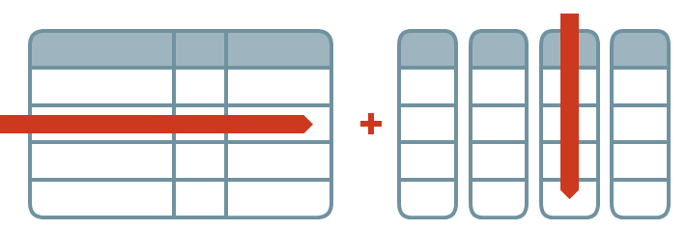
In-Memory Column Store
Buffer Cache
IMCS
SGA Parameters
INMEMORY_SIZE
Table Parameters
Compression Level
Priority (optional)
Row Storage
Columnar Storage
How do we measure it?
V$IM_SEGMENTS
V$INMEMORY_AREA

Slide 18
In-Memory Pools
1MB Pool
IMCU
Used to store actual data populated in columnar format
Subunits knows as In-Memory Compression Units (IMCU)
Column stores composed of 1MB extents
Data can be stored over one or more IMCU
1MB Pool Size = (0.8 * INMEMORY_SIZE)
IMCU
64KB Pool
SMU
SMU
Dynamic Performance Views
Contains IMCU metadata and transactional information
Individual subunits known as Snapshot Metadata Units
64KB Pool Size = (0.2 * INMEMORY_SIZE)
SMU
SMU
v$inmemory_area
v$im_header
v$im_smu_head
V$im_segments
SMU
SMU
IMCU
SMU
SMU
SMU
SMU
SMU
SMU

Slide 19
Experiment # 3: In-Memory Column Store
We manually set…
ALTER SYSTEM SET PARALLEL_DEGREE_POLICY = AUTO
ALTER SYSTEM SET DB_CACHE_SIZE = 32G SCOPE=SPFILE
ALTER SYSTEM SET INMEMORY_SIZE=192G SCOPE=SPFILE
New Default (no temp)
/*+ PARALLEL(32) */
ALTER SYSTEM SET “PGA_MAX_SIZE” = 4G
We forced tables to be In-Memory
ALTER TABLE [table name] INMEMORY MEMCOMPRESS FOR QUERY LOW PRIORITY CRITICAL
We waited for the table to fully populate In-Memory
V$IM_SEGMENTS
Monitor population status and size
We tracked resource usage
Time (Run Time, CPU Time, IO Wait, DB Time)
How does IM compression change query speed?
How does compression option change object size in memory?

Slide 20
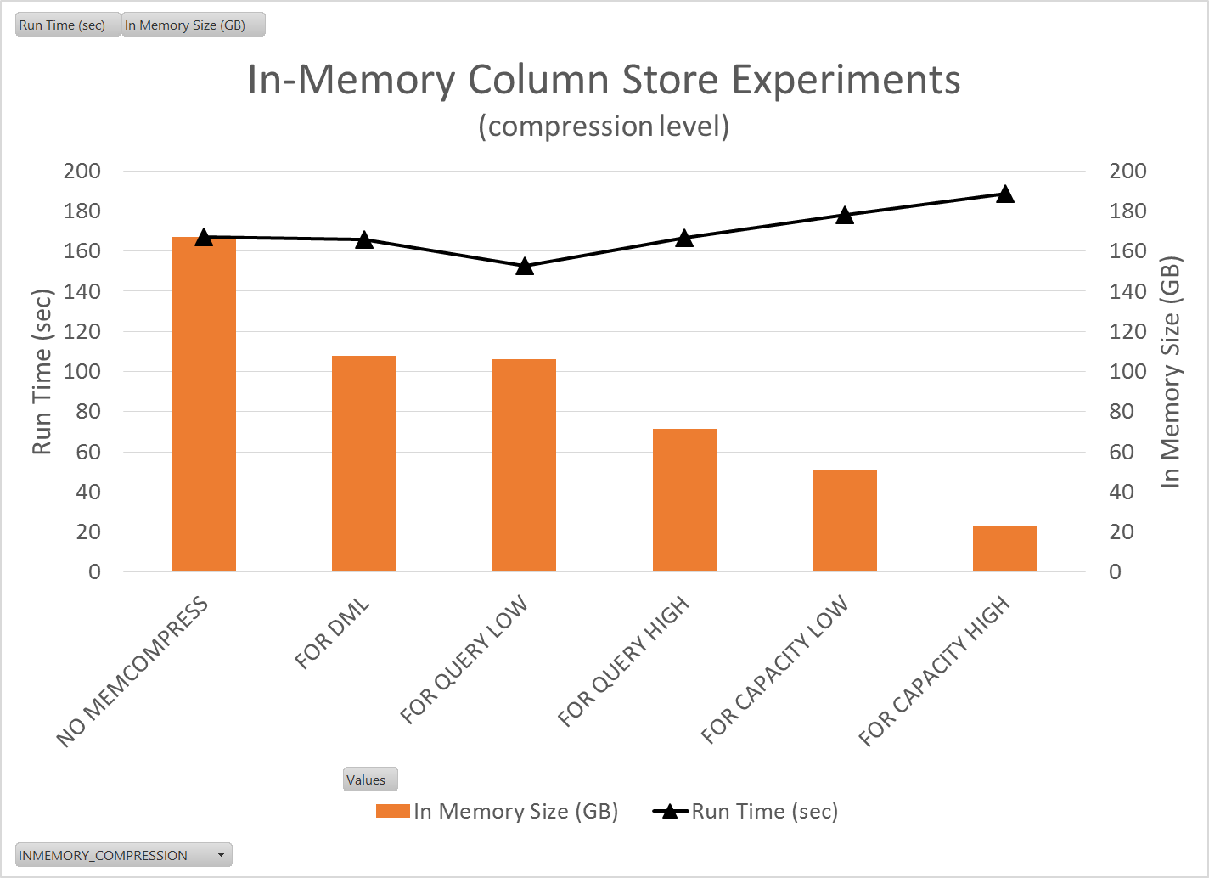
Experiment # 3: In-Memory Column Store
“For Query Low” looks like a great choice
Best performance (3.2X faster than going to disk)
Decent compression (37% reduction)
For huge tables you could do “For Capacity High” so as not to use up all your In-Memory space.
Still get a 2.6X improvement over going to disk
78% reduction in size for our data

Slide 21
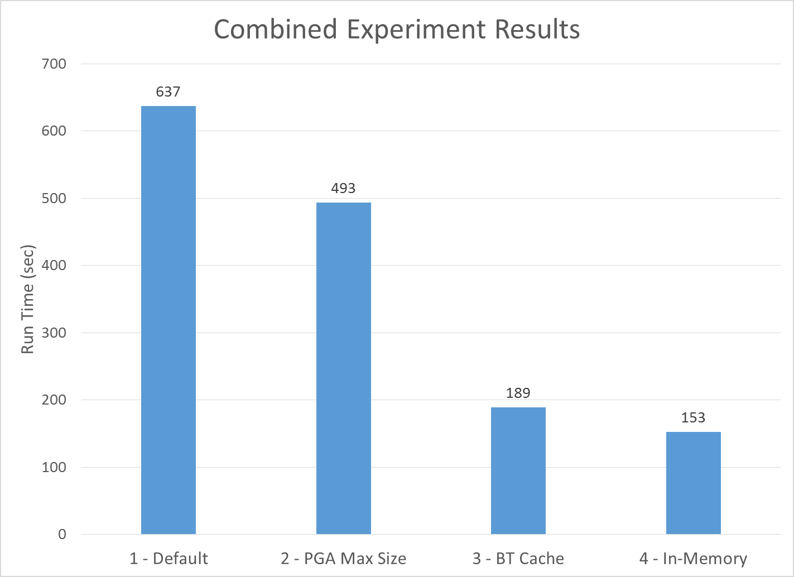
Let’s Put It All Together…
Summary
1.3X improvement from not going to temp
3.4X improvement from also caching big tables
4.2X improvement from using In-Memory
One Big Caveat…
All experiments were run serially
No competition for resources
No other work being done on the system
Not a real-world test case
So lets do a bunch of stuff all at once and see what happens…

Slide 22
Experiment # 4: Statement Queuing
With Statement Queuing
Queries are allocated the desired level or resources
When PARALLEL_SERVERS_TARGET is surpassed, statements get queued
Without Statement Queuing
Queries are all started as soon as they arrive, and CPU is downgraded causing some queries to run quickly, and some queries to run VERY slow.
Queuing
Time
No Queuing
Statements Downgraded

Slide 23
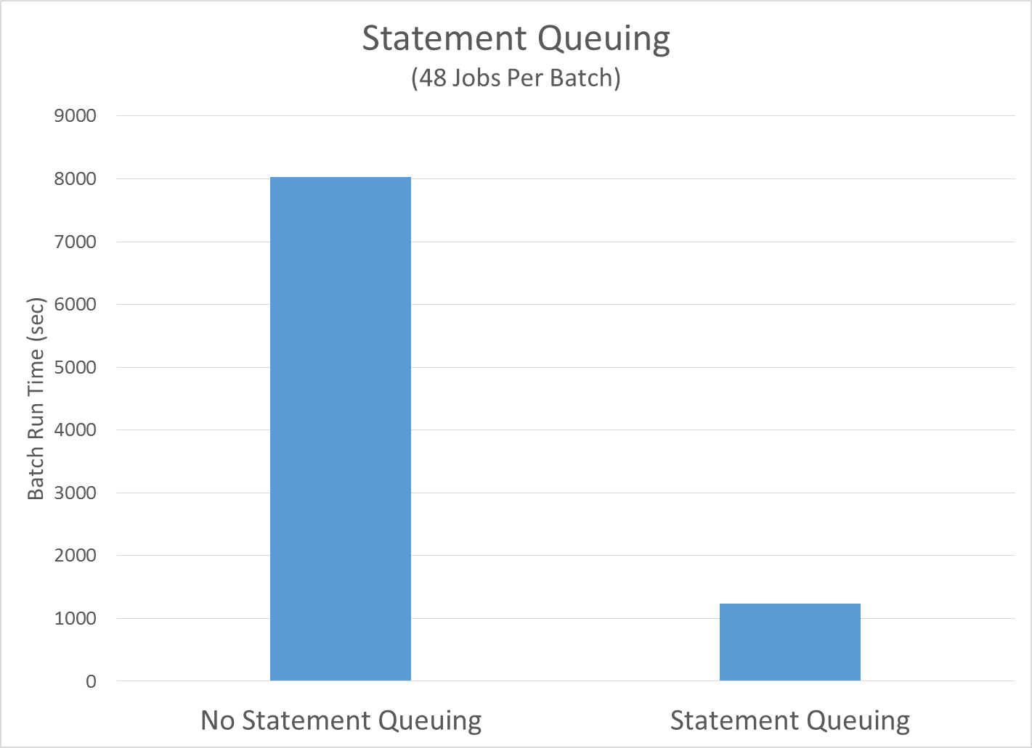
Experiment # 4: Statement Queuing
Summary
Statement queuing works like expected!
Without queuing most jobs get massive downgrading and therefore lots of swap to temp
Data was In-Memory for both sets of tests.
With queuing each job gets the optimal resources it needs to execute
Not shown:
If you keep in parallel hints and have queuing turned off your queries will start to die with: ORA-04036: PGA memory used by the instance exceeds PGA_AGGREGATE_LIMIT

Slide 24
Conclusions
Going to temp is bad
Changing _PGA_MAX_SIZE allows us to increase our work area size without drastically increasing our DOP
Putting data into memory is good
Big table caching is a good alternative if you don’t have the In-Memory option
In-Memory column store is very performant
Statement Queuing works well!

Slide 25
Future Work
What we still want to learn
What we think we know
What we probably don’t fully understand

Slide 26
Future Work
What happens with…
Resource Manager
Partitioning and parallel queries
Share everything vs. share nothing
Table compression and parallel queries
Indexing and In-Memory
DML and In-Memory
Roll to production

Slide 27
Acknowledgements
Hotsos!
OSU Computer Science Students
Nathaniel Whitlock
Nic Desilets
All the great Oracle Bloggers

Slide 28
Questions?

